Slide 1
MGCFA
Example

Slide 2
Lavaan – Equality Constraints
We’ve talked before about setting paths equal to each other by calling them the same parameter name
Cheese =~ a*feta + a*swiss
So feta and swiss will be estimated at the same value.

Slide 3
Lavaan – Equality Constraints
One way to do the steps:
group.equal = “keyword”
Put in the sem() or cfa() function

Slide 4
Lavaan – Equality Constraints
Options for group.equal
loadings (for manifest)
intercepts (for manifest)
means (for latents)
residuals (for manifest)
residual.covariances (for manifest)
lv.variances (for latents)
lv.covariances (for latents)
regressions (for manifest)

Slide 5
Lavaan - semTools
However, when doing the steps for multigroup testing, I would have to run each model separately.
If you install semTools (library), you can run all the steps at once with measurementinvariance() function.
Woo!

Slide 6
Example
RS14 Scale!
A one factor model of resiliency
Gender
Men = 1
Women = 2
Ethnicity/Race
Black = 1
White = 2

Slide 7
Overall Model
First, let’s program the overall model to make sure it fits ok.
NEW: meanstructure = TRUE
Gives you the intercepts and means in the model.
You want to turn that one at the beginning, and you are first examining models with means, so you can tell if you have bad parameters at the start.
The measurement invariance function using meanstructure = TRUE, so we want to match it.

Slide 8
Overall Model – Data, Run, Interpret
Import the data file, as you need all the data or at least two covariance tables for this analysis to work properly.
Always make sure your variables are: factored, and do not contain things you are not expecting.
Build a 1 factor model CFA.
Run and interpret that model.
Overall, it should be good.
Remember, we expect fit to decrease as we go, so you need to start ok.

Slide 9
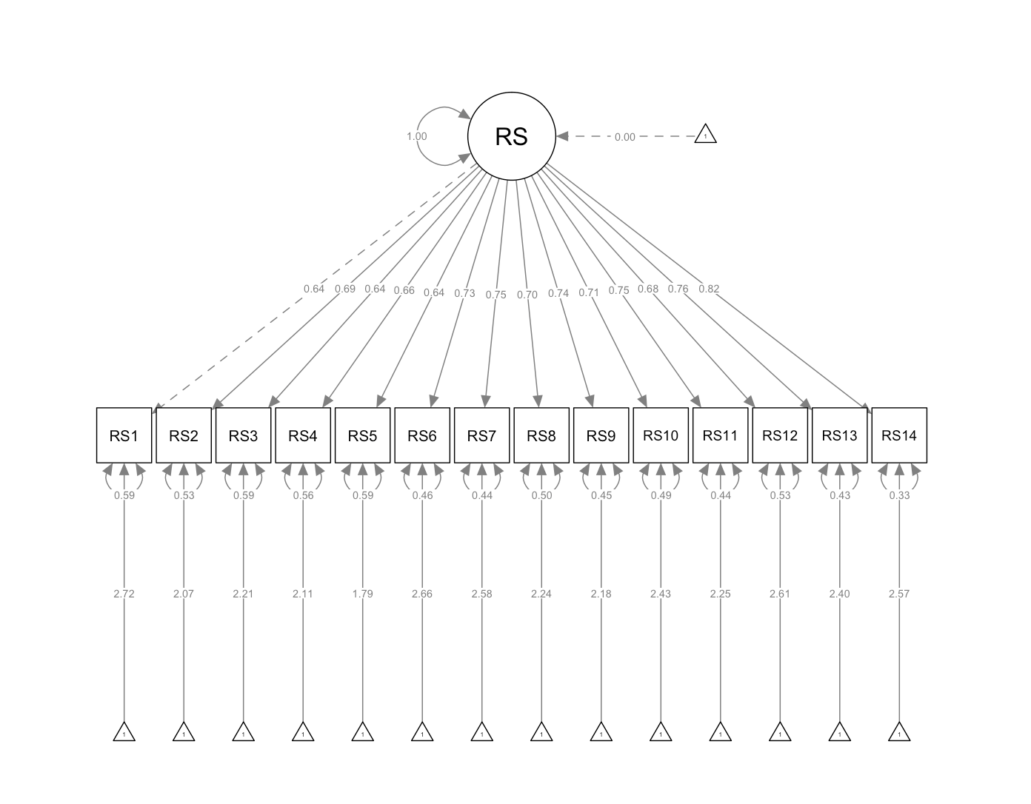
Overall Model
Fit for the model
CFI = .927
RMSEA = .086
SRMR = .041
X2(77) = 368.984

Slide 10
Separate Group Models
Test men and then women separately before nesting them together.
Subset the data into two smaller datasets.
Then run that same overall model for each group separately.

Slide 11
Separate Group Models
 | Men | Women
CFI | .920 | .895
RMSEA | .102 | .094
SRMR | .041 | .052
X2(77) | 271.457 | 258.610
The women model fit is a little bit worse, but we won’t know if it’s significant (or where) until we combine them.

Slide 12
Run MG Invariance Steps
Load the semTools library.
measurementinvariance(model,
data = data, ##go back to the big dataset
group = ‘group variable name’,
strict = TRUE)

Slide 13
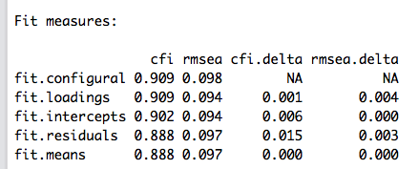
Run MG Invariance Steps
Look at the output for change in CFI:
We can interpret from here, but I am going to use the next couple slides to walk through what this function does.

Slide 14
Configural Invariance
Now, combine the models together and determine if they have the same factor structure.
What is happening in background:
Use the group function in the CFA code.
group = “variable name”
cfa(model, data = data, meanstructure = TRUE, group = “group”)

Slide 15
Configural Invariance
 | Configural | Metric | Scalar | Strict
CFI | .909
RMSEA | .098
SRMR | .047
X2 | (154) = 530.067

Slide 16
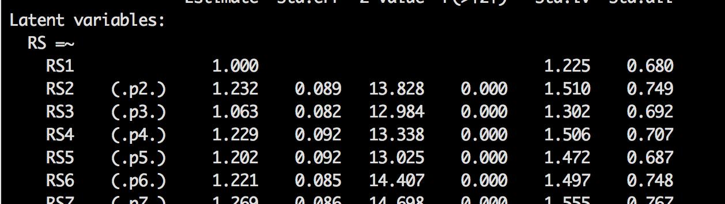
Metric Invariance
For metric invariance, we are going to set loadings across groups equal.
What is happening in background:
Use the code group.equal=c(“loadings”) in the sem() or cfa() function.
Check out what that does in the output
cfa(model, data = data, meanstructure = TRUE, group = “group”, group.equal = c(“loadings”))

Slide 17
Metric Invariance
 | Configural | Metric | Scalar | Strict
CFI | .909 | .909
RMSEA | .098 | .094
SRMR | .047 | .057
X2 | (154) = 530.067 | (167) = 545.518
DIFFERENT? | n/a | NOPE CFI = 0.000

Slide 18
Scalar Invariance
Intercepts are set to equal by adding “intercepts” to the group.equal part in the background.
We are slowly making the model more restrictive, so you want to add constraints, not just change them.
cfa(model, data = data, meanstructure = TRUE, group = “group”, group.equal = c(“loadings”, “intercepts”))

Slide 19
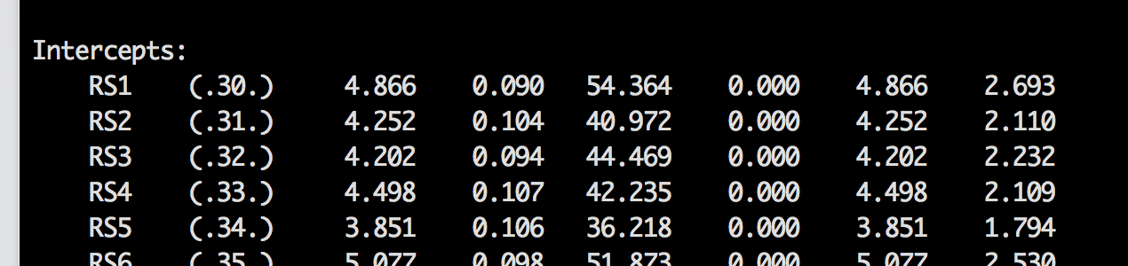
Scalar Invariance

Slide 20
Scalar Invariance
 | Configural | Metric | Scalar | Strict
CFI | .909 | .909 | .902
RMSEA | .098 | .094 | .094
SRMR | .047 | .057 | .060
X2 | (154) = 530.067 | (167) = 545.518 | (180) = 585.327
DIFFERENT? | n/a | NOPE CFI = 0.000 | NOPE CFI = .007

Slide 21
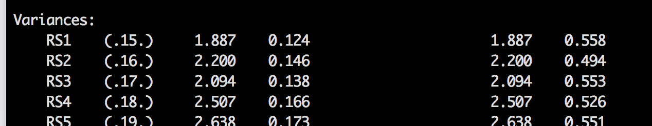
Strict Invariance
Residuals for the manifest variables are set to equal by adding in residuals to the group.equal part.
cfa(model, data = data, meanstructure = TRUE, group = “group”, group.equal = c(“loadings”, “intercepts”, “residuals”))

Slide 22
Strict Invariance
 | Configural | Metric | Scalar | Strict
CFI | .909 | .909 | .902 | .888
RMSEA | .098 | .094 | .094 | .097
SRMR | .047 | .057 | .060 | .062
X2 | (154) = 530.067 | (167) = 545.518 | (180) = 585.327 | (194) = 660.398
DIFFERENT? | n/a | NOPE CFI = 0.000 | NOPE CFI = .007 | YES CFI = .014

Slide 23
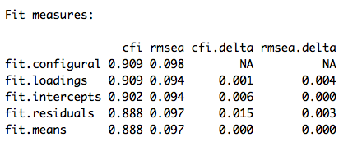
Interpreting Real Output
I can see the fit.residuals is bad, which is the strict step.
Note this thing also runs means for you (which you can ignore if you don’t want).

Slide 24
So what now?
Partial invariance
We have to figure out where the problem is for our residuals that says they aren’t equal.
We’ll use the partialinvariance function to find the biggest issue but only for the items in the step you were having problems with.

Slide 25
Partial Invariance
Figure out which level you need:
##metric =~ for loadings
##scalar ~1 for intercepts
##strict ~~ for variances
Run and save partial invariance code:
partialinvariance(saved multigroup fit, type = “step that broke”)

Slide 26
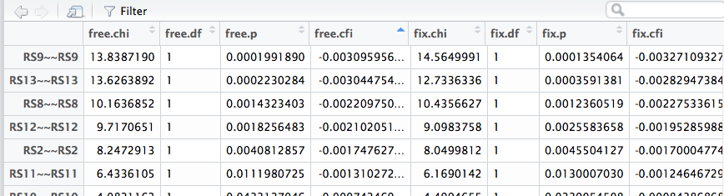
Partial Invariance
This function saves a lot of output, so if you save the $results, you’ll be able to look at only part of it.
Then click on what you saved, and you can sort and view them.

Slide 27
Partial Invariance
Pick the largest one in the free.cfi column.
Since that constraint is the problem, we are going to let it go free!
group.partial = c("RS9 ~~ RS9") is added to the cfa() or measurementinvariance() function.
This function is super sweet with measurementinvariance FYI.
You can add more here if you want, but do one of them at a time to determine when to stop.

Slide 28
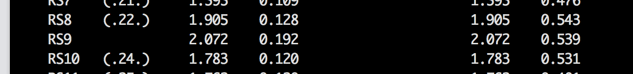
Partial Invariance
Women
Men
Think about partial invariance as mini t-tests.

Slide 29
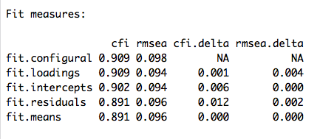
Strict Invariance
 | Scalar | Strict | RS9 Free
CFI | .902 | .888 | .891
RMSEA | .094 | .097 | .096
SRMR | .060 | .062 | .062
X2 | (180) = 585.327 | (194) = 660.398 | (193) = 646.559
DIFFERENT? | NOPE CFI = .007 | YES CFI = .014 | YES CFI = .011
NOTE: compare to scalar not strict.

Slide 30
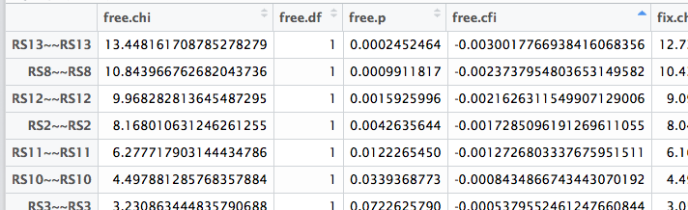
Strict Invariance
We didn’t come up enough with CFI to find partial strict invariance.
Let’s try the next worst constraint.
Repeat the procedure from earlier on the new fit.
Be sure you are adding inequalities as you go, don’t replace.

Slide 31
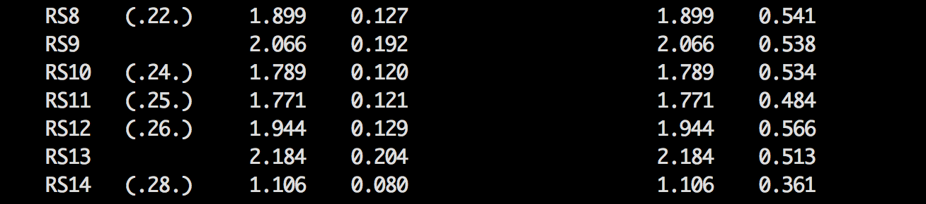
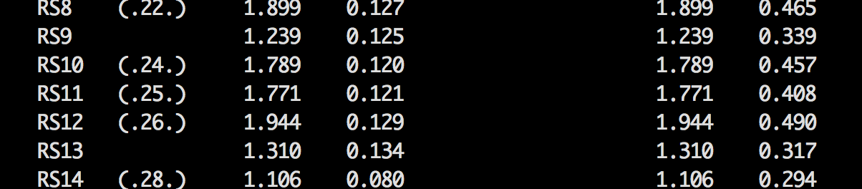
Partial Invariance
Women
Men
Think about partial invariance as mini t-tests.

Slide 32
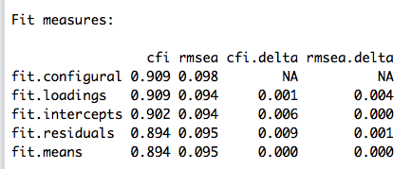
Strict Invariance
 | Scalar | Strict | RS9 Free | RS13 Free
CFI | .902 | .888 | .891 | .894
RMSEA | .094 | .097 | .096 | .095
SRMR | .060 | .062 | .062 | .062
X2 | (180) = 585.327 | (194) = 660.398 | (193) = 646.559 | (192) = 633.111
DIFFERENT? | NOPE CFI = .007 | YES CFI = .014 | YES CFI = .011 | NO CFI = .008
NOTE: compare to scalar not strict.

Slide 33
Interpretation
The RS is mostly invariant – the structure, loadings, intercepts, and most of the error variances are the same across men and women.
However, two items show larger variances:
RS9
RS13
Where, women show much larger variances on both of those questions.
I keep interested in things.
My life has meaning.

Slide 34
Interpretation
How do I get all the numbers for each step?
Pull them from the last run of your model:
modelfit$fit.configural
modelfit$fit.loadings
modelfit$fit.intercepts
modelfit$fit.residuals

Slide 35
Latent Means
You can analyze if latent means are different across groups using the same procedures with group.equal = c(“means”)
However, let’s say you want to use the weighted means as a predictor in a later analysis
Or we can calculate a t.test to determine if they are different and get effect sizes.

Slide 36
Latent Means
Think about this for a second:
We normally use EFA/CFA to show that each question has a nice loading and the questions “go together”
And then we totally ignore the fact that the loadings are different and just create total scores or average scores.
Why lose that information?

Slide 37
Latent Means
You will calculate the latent score for each person by multiplying their individual item score times the loading
Then you can average them or total them depending on how the scale is traditionally scored

Slide 38
Latent Means
You will take the estimates for the loadings for each factor
So, if you have two factors you will need the weights for each one but separately, aka don’t just average them all together.
Make sure you are multiplying the right things!

Slide 39
Latent Means
First, save the loadings:
loadings = parameterestimates(last model fit)
Now view the loadings – it’s very similar to saving the modinces, which means we can subset them.

Slide 40
Latent Means
Subset out the loadings by group and type.
We want to use =~ for regression weights.
The select part gets you only the estimates.
menload = subset(loadings, group == "1" & op == "=~", select = "est")
womenload = subset(loadings, group == "2" & op == "=~", select = "est")

Slide 41
Latent Means
Now, we have the loadings and want to multiply them by the original scores.
Be sure you’ve separated the data into groups!

Slide 42
Latent Means
Apply function:
Arguments (dataset, 1 for rows / 2 for columns, function)
Make sure the columns in the same order!
menmultiply = apply(men[, 4:ncol(men)], 1, function(x) { x * menload })
womenmultiply = apply(women[, 4:ncol(women)], 1, function(x) { x * womenload })

Slide 43
Latent Means
Apply is great! But it saves as a list. Lame.
So change that over to a data frame.
menmultiply = as.data.frame(menmultiply)
menmultiply = t(menmultiply)
##flip it so it's people per row rather than question by row

Slide 44
Latent Means
To get the mean for each person:
menlatent = rowMeans(menmultiply)
womenlatent = rowMeans(womenmultiply)
If you want to get the sum:
menlatent = rowSums(menmultiply)
womenlatent = rowSums(womenmultiply)

Slide 45
Latent Means
Let’s do a t.test to see if they are different
t.test(group 1, group 2, …)
The rest of the arguments are not required but wanted to show them to you if you wanted to change them to one tailed.
t.test(menlatent, womenlatent,
alternative = "two.sided",
paired=FALSE,
var.equal = TRUE,
na.action=TRUE)

Slide 46
Latent Means
Effect sizes!
Install the effsize package
library(effsize)
cohen.d(menlatent, womenlatent)
cohen.d(group 1, group 2, paired=FALSE)
PS – this function only works for a couple types of Cohen’s d, so if you want more options, please view the video about Dr. B’s effect size code.
But it’s a quick way to get independent and dependent t (differences) ☺

